Slide 1
Data Science with Python
muksurat choudhury

Slide 2
Data Visualisation
Using the linked dataset produce a series of visualisations demonstrating the use of Matplotlib. You should produce at least one of the following:
● Bar Graph
● Pie Chart
● Box Plot
● Line Chart
● Scatter Plot
Once you have demonstrated use of the different plots you should look at the data and make some conclusions from the data set.
● Can you find any links? ● Present your conclusion illustrated with appropriate visualisations. ● Submit your completed notebook.

Slide 3
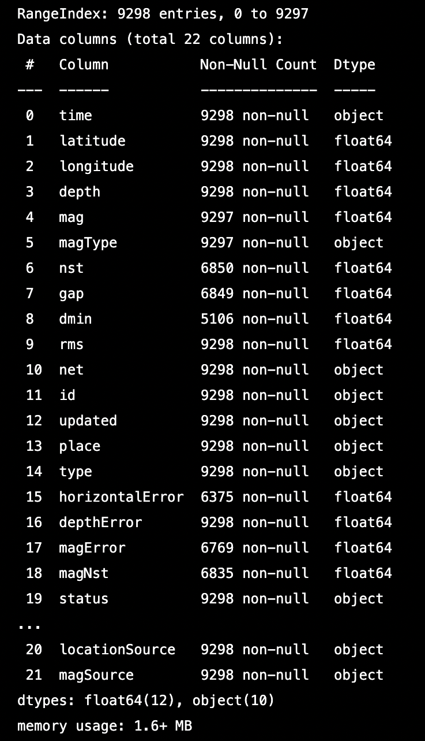
The Data
import numpy as np
import matplotlib.pyplot as plt
import pandas as pd
import seaborn as sns
Notes:
I began with importing modules I would be using: numpy, matplotlib, pandas and seaborn
I viewed the information within the data here to see there are 9298 entries, the data types are float64 and memory usage is 1.6+ MB

Slide 4
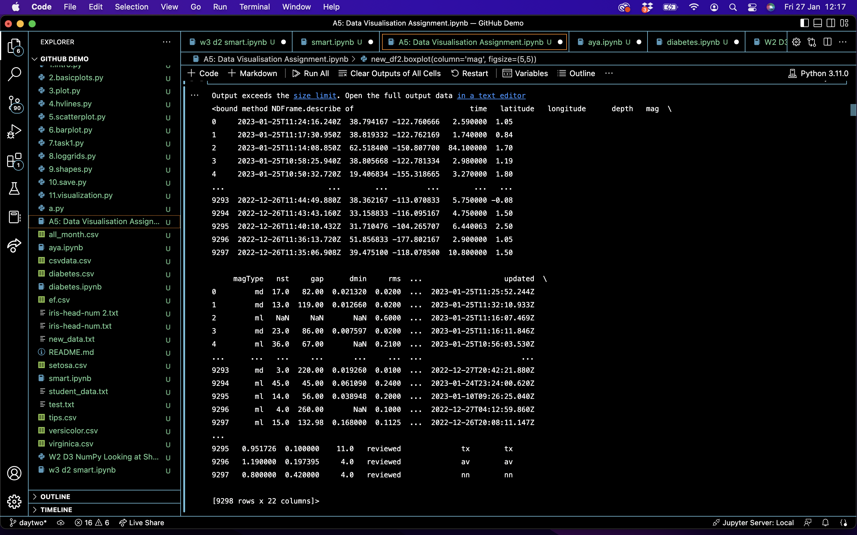
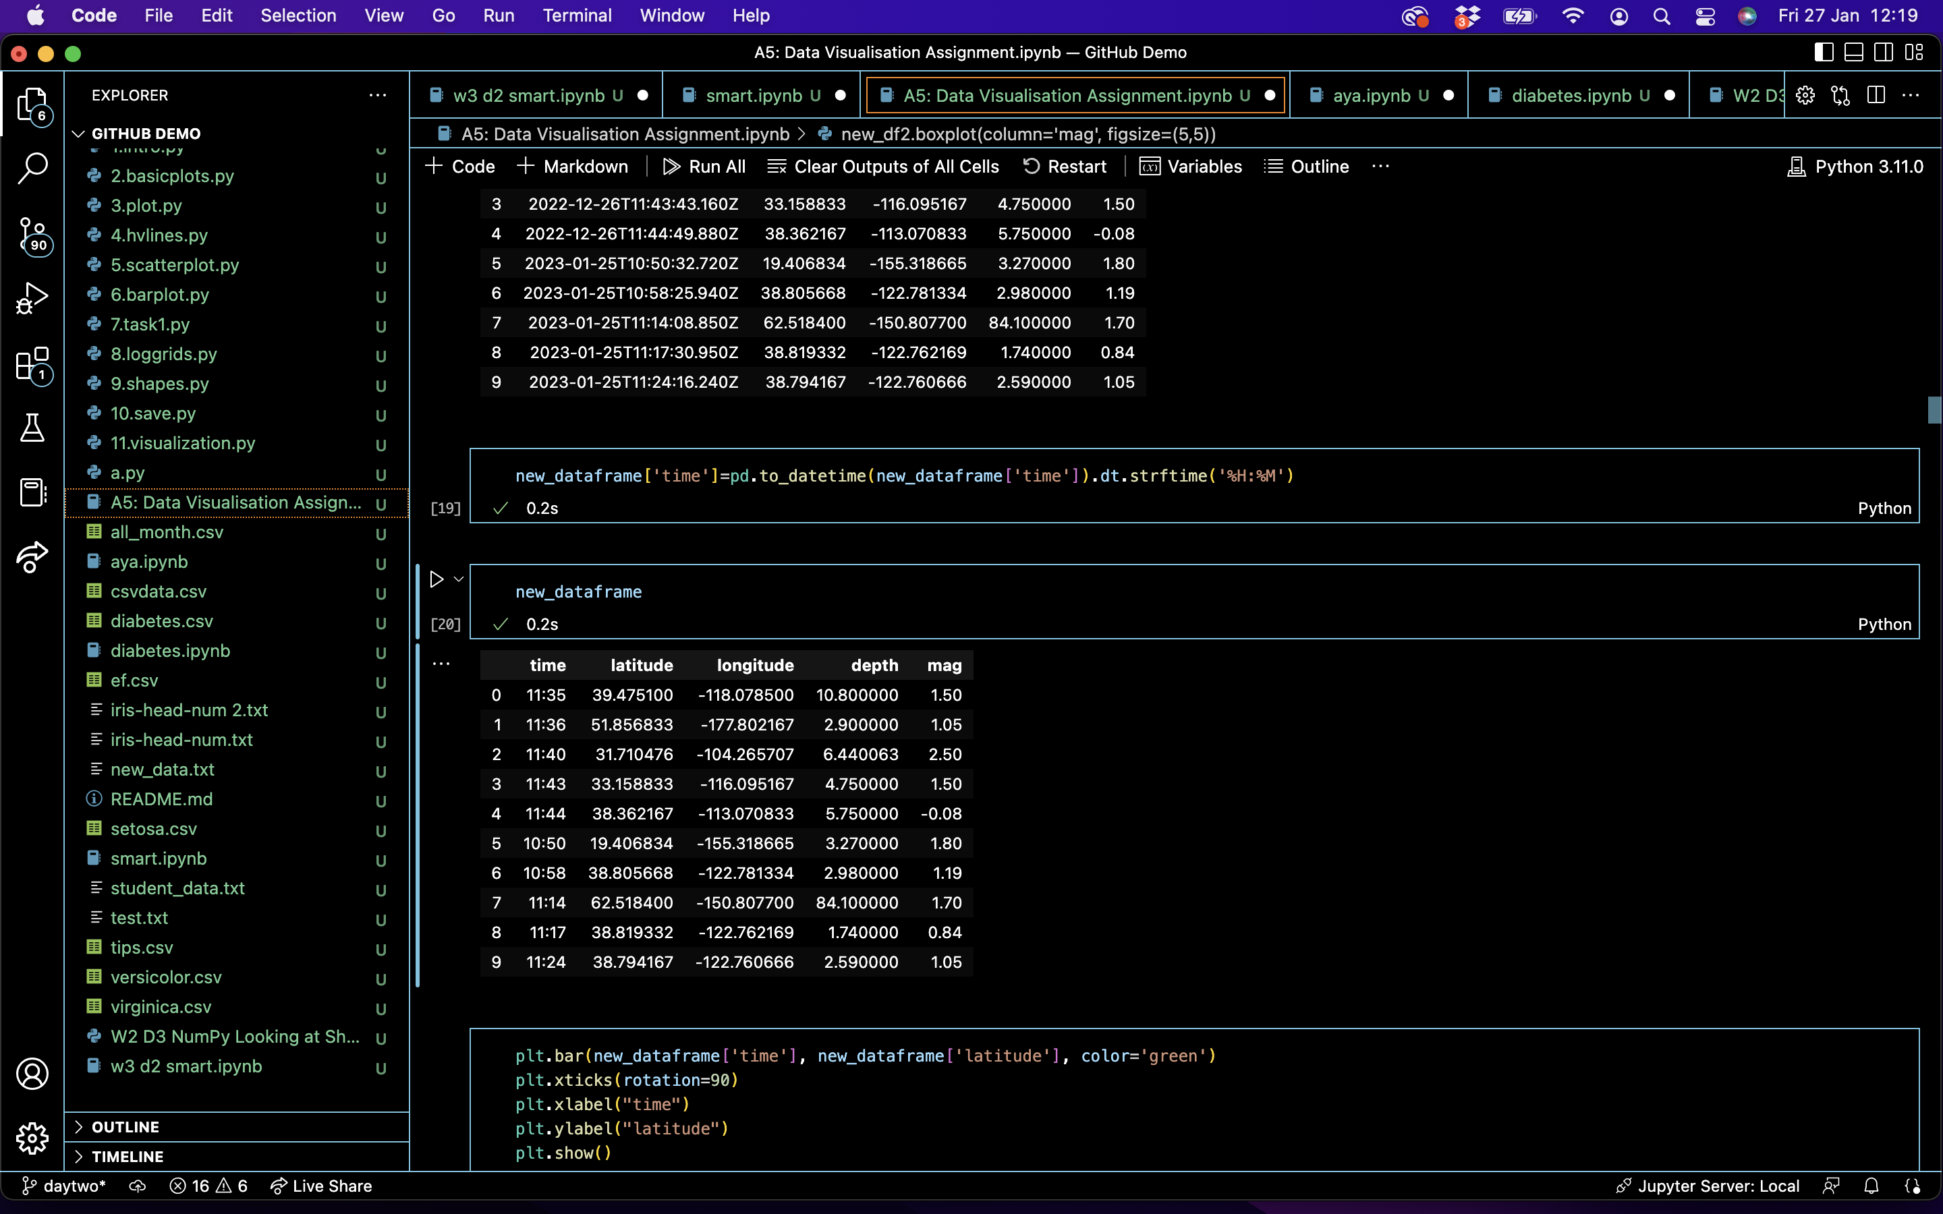
Notes:
This is the data description on the left
Since it’s a lot of data, I condensed it to show me only the time, latitude, longitude, depth and magnitude, but it was still 9298 rows of data so
I condensed it further to show me only the first 5 results and the last 5 results from the dataset and this is the information I worked with

Slide 5
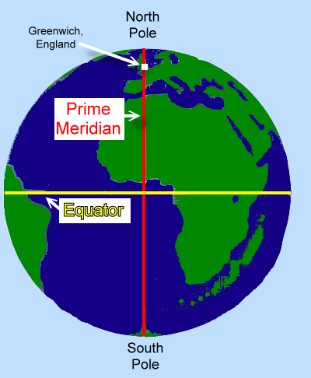
latitude
Distance on the surface of the Earth measured in degrees north and south of the equator
longitude
Distance on the surface of the Earth measured in degrees east and west of the prime meridian (Greenwich)
depth
Measures the distance beneath mean sea-level
Usually in Kilometres
magnitude
The earthquakes size or strength as a measure of seismic waves (the degree of shaking)
Notes:
When we think about locating an earthquake, we first need to determine the origin time, the coordinates of the hypocentre and the earthquake’s magnitude and size
The hypocentre is the point on earth where the earthquake originates
To find this we use latitude to measure the distance north and south of the equator and longitude to measure the distance east and west of the prime meridian which is Greenwich
The depth measures the distance beneath mean sea-level, the data is usually in kilometres
The magnitude describes the earthquakes size in terms of strength of the seismic waves and the degree of shaking that is caused

Slide 6
Data Visualisation
Pie Chart
Bar Graph +
Histogram
Scatter Plot
Line Chart
Box Plot
Notes:
So these are the charts I made, I won’t talk about them all, but I’d like to show you them briefly

Slide 7
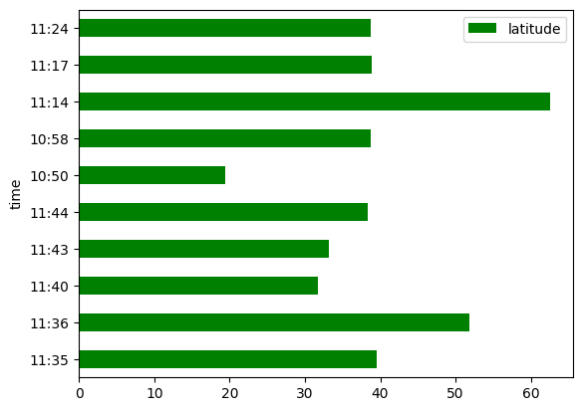
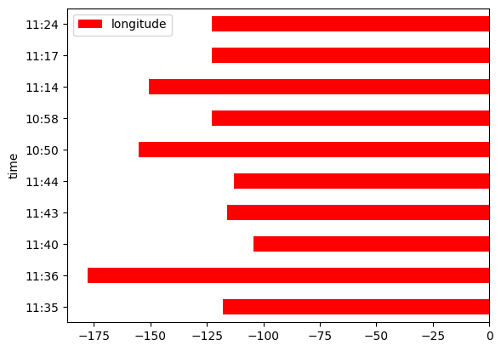
Bar Graph
Notes:
Due too the large size of the data, I have taken a sample of the first 5 results and the last 5 results of the dataset
These bar charts shows us the latitude and longitude according to the time of day by hour and minutes
Each degree of latitude or longitude is 111.1 km on the Earth’s surface and together they can pinpoint the coordinates to determine the location of an earthquake

Slide 8
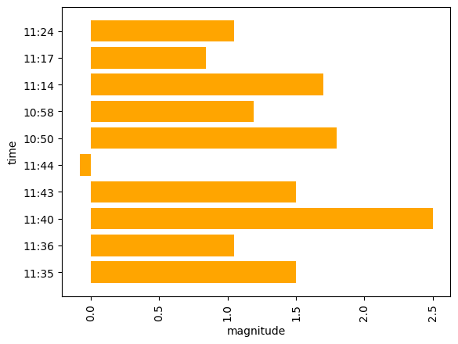
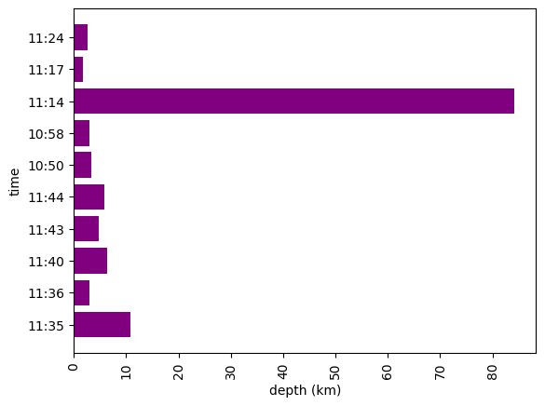
Bar Graph
Notes:
Using the first 5 results and the last 5 results of the dataset again
These bar charts shows us the the magnitude and the depth according to the time
The earthquake with the highest magnitude at 2.5 was at 11.40, while it’s depth was low at 6.4 km, meaning the magnitude was strongest when the earthquake was not that far beneath the mean sea-level

Slide 9
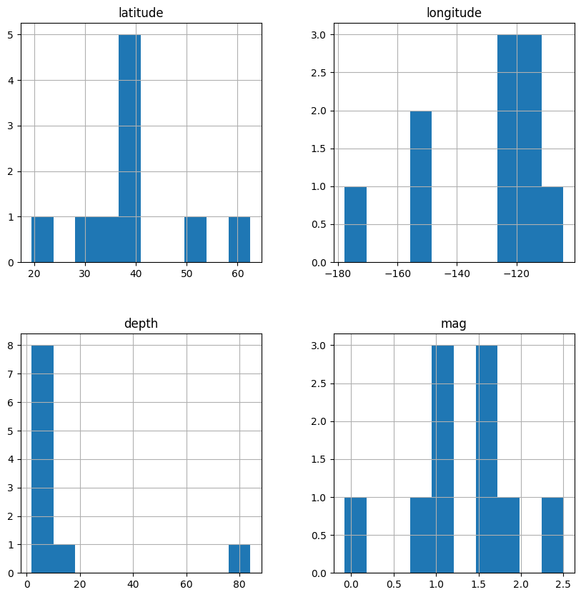
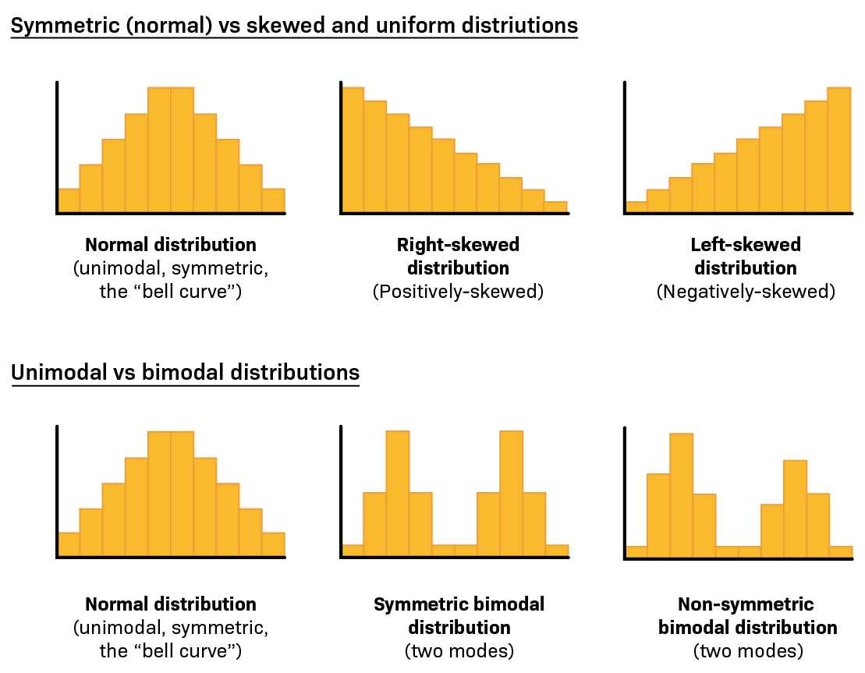
Histogram
Week 3: Assignment 5
Notes:
I created this histogram so you can see a collated visualisation of the shape of the data from the previous charts using the latitude, longitude, depth and magnitude of the 10 results
You can see:
The latitude has normal distribution
The longitude is negatively skewed
The depth is positively skewed
The magnitude is symmetric bimodal distribution

Slide 10
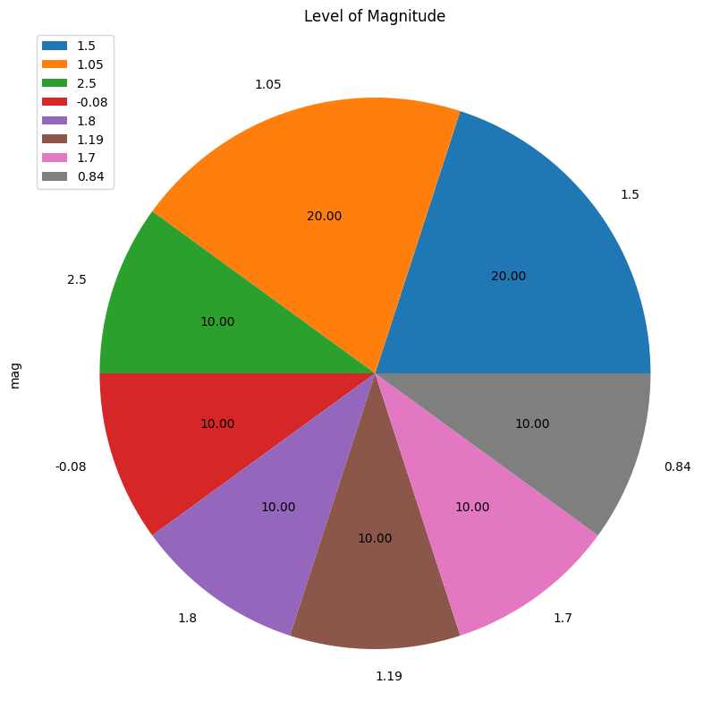
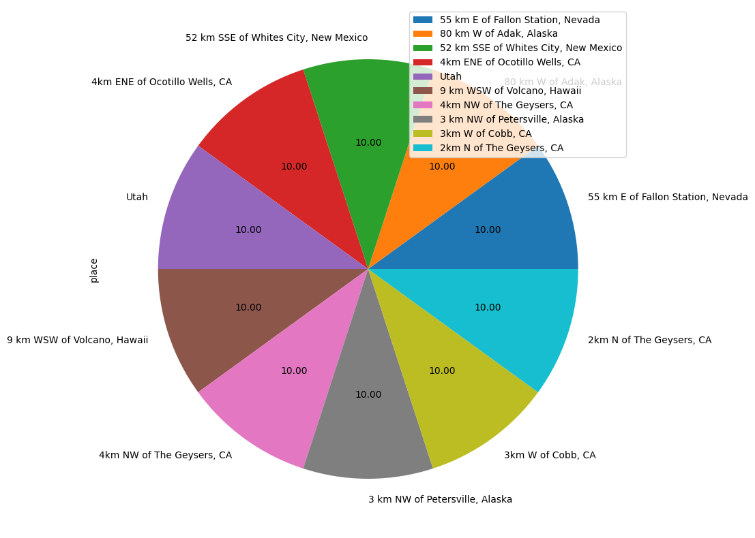
Pie Chart
Notes:
Using the same 10 results only
The first pie chart shows that 20% of the 10 earthquakes have magnitudes of 1.05 and another 20% have a magnitudes of 1.5, while the other levels of magnitude only occurred once or 10% each
The second pie chart shows the location of each earthquake is different, no two earthquakes from these 10 results happened in the same location

Slide 11
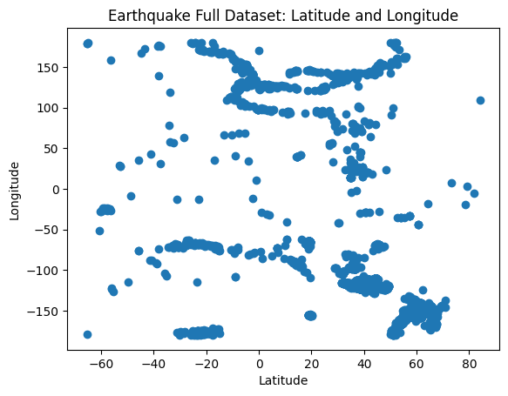
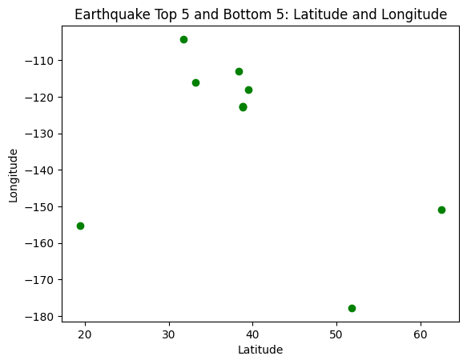
Scatter Plot
Week 3: Assignment 5

Slide 12
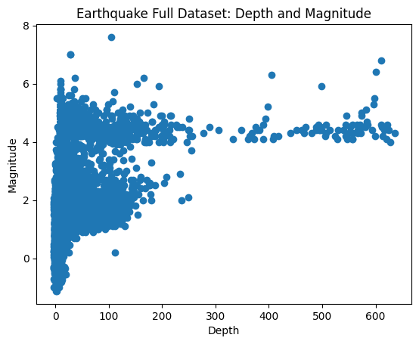
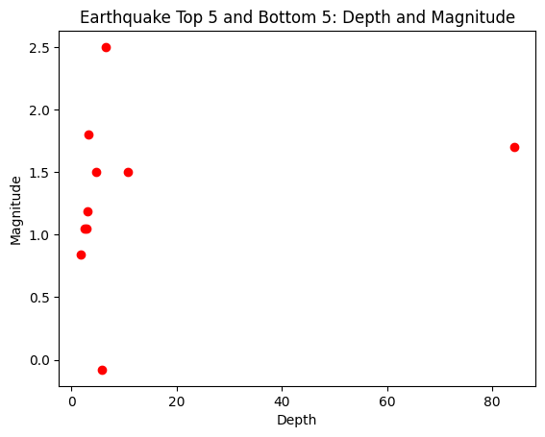
Scatter Plot
Week 3: Assignment 5

Slide 13
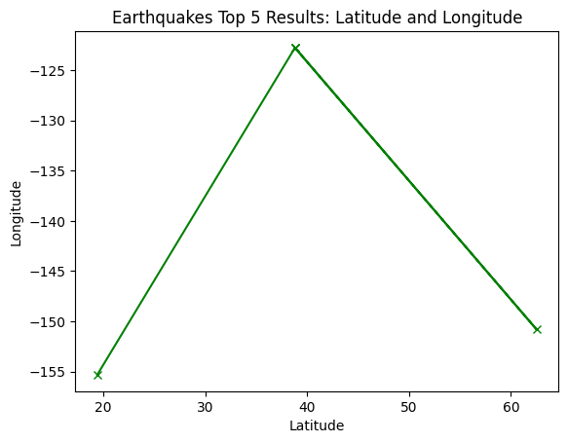
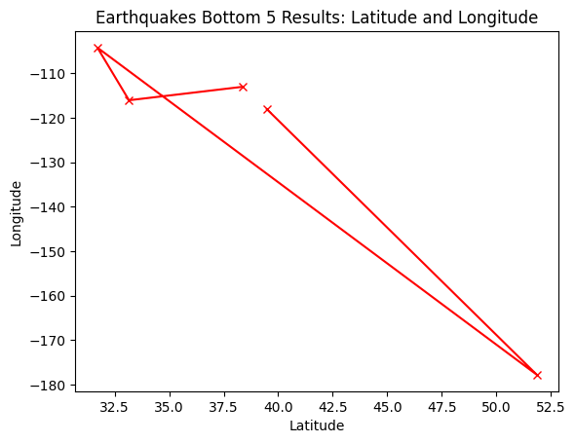
Line Chart

Slide 14
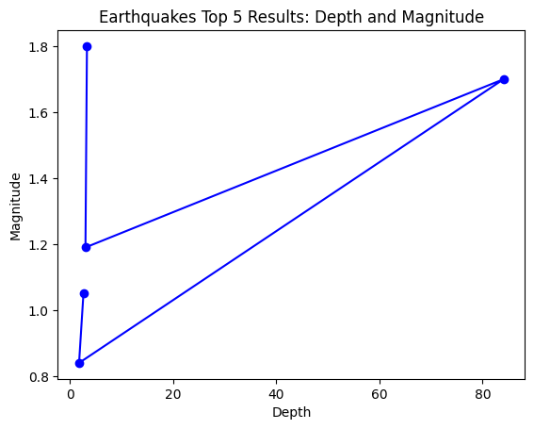
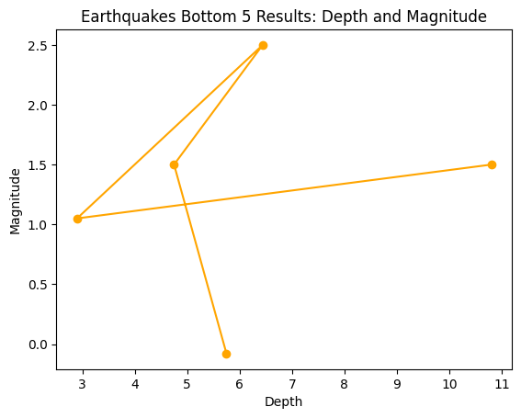
Line Chart

Slide 15
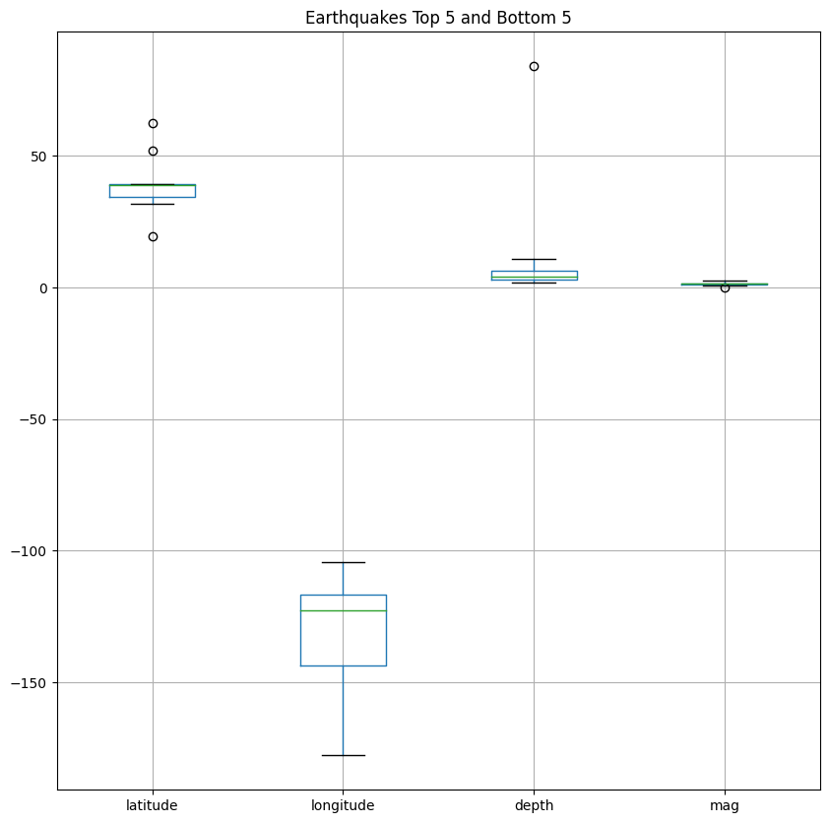
Box Plot

Slide 16
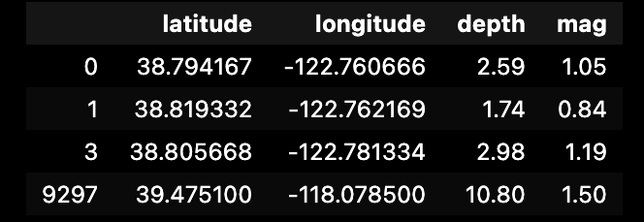
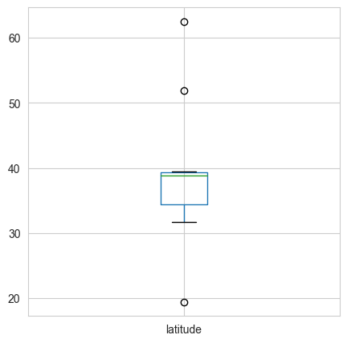
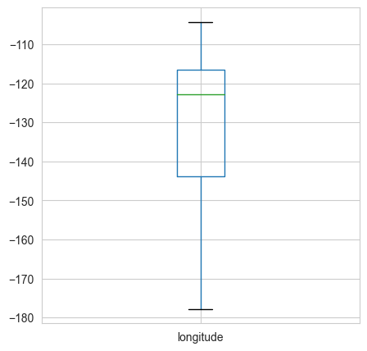
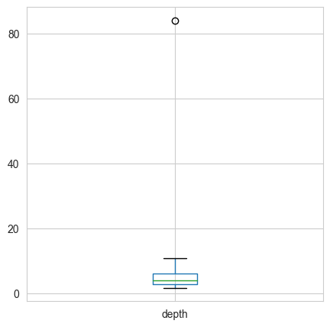
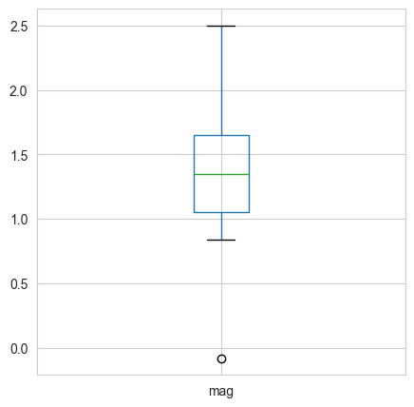
Box Plot
outliers

Slide 17
Thank you

